Slide 1
OU Student Performance Analysis
Hello!
Sharon Li
Hi!
Notes:
Thank you for coming today. My name is Sharon, I have already met the most of you on Wednesday. It’s also such a pleasure to be here today and deliver my data challenge project. The title of today’s presentation is Open University Student Performance Analysis.

Slide 2
Table of Contents
Introduction
Data Science
Background
Vison & Goals
Feature Engineering
Data Cleaning
Machine Learning
Analysis
Conclusion
Causal analysis
Solutions
Measurement
Summary
Limitation & Future Work
Notes:
Now, let us see today’s agenda. My presentation contains 4 parts. Firstly, I will have a project introduction, give you a generic background of the Open University and define the problems I am gonna solve. Secondly. I will go over all the data science work, including how I extract features from the dataset, how I clean and filter them. Then, I will conduct a causal analysis and tell you what factors lead to the problem, give you actionable insights I made along with the measurement. Finally, I will give a overall summary of my achievement in the project, find limitation of this problem and guide a future work.

Slide 3
Introduction
Notes:
Let’s dive into the introduction part!

Slide 4
Background
Virtual Learning Environments
170,000
Notes:
Who has ever had an online learning experience?
With the rapid growth of information technologies, the Virtual Learning Environments emerged and moved courses to the Internet. This transfer was further supported by the boom of Massive Open Online Courses (MOOCs). The Open University is one of the largest distance learning universities worldwide. At present, around 170,000 students are registered in different programs. Teaching materials and other content are delivered to students via the VLE.

Slide 5
Background
VLE opens
Assessment 1
Assessment N
Ends
Starts
Assessment 2
Exam
Timeline of a module - presentation
What course? When?
Notes:
At the OU, courses are called modules. Modules can be presented multiple times during the year. They use the combination of module and presentation to distinguish between module starts at different month in a year.
This Figure depicts the typical structure of one module-presentation. Module resources are available from the VLE system a few weeks before the start of the presentation. Students can sign-up for the module from a few months before the start of the presentation until two weeks after the official module start date. Each module includes several assessments. At the end of the module, there is usually a final exam.

Slide 6
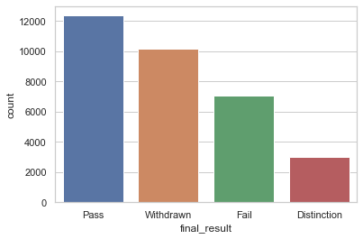
Background
However ……
Over half of students ended with withdraw or fail
37.9%
31.2%
21.6%
9.3%
52.8%
Notes:
This is the frequency of the final result. From this figure, we can see that
Although the VLE gives students more opportunities to learn, over half of students ended with withdraw or fail.

Slide 7
Vision & Goal
Visions：
● Reduce fail and withdraw rate.
● Help students get a better learning experience.
Goals：
● Identify potential causes of fail or withdraw a class.
● Come up with actionable suggestions.
● Come up with method to measure the impact of the solutions.
● Deliver reusable models to predict future student assessment results.
Notes:
Since that, I want to reduce fail and withdraw rate, at the same time, help students get a better learning experience.
I have 4 goals in this project. Firstly, I want to identify the causation of students fail or withdraw a class, and then come up with actionable suggestions according to that. To prove the effectiveness of my suggestions，I also delivered measurement to track students’ performance after launching the suggestions. Finally, I hope to deliver reusable models to predict students results in the future.

Slide 8
Stakeholders
● Students
● Course Administrators
● Course Platforms
● Researchers
Notes:
This is a student oriented project, my biggest wish is to help students gain a better learning experience.
Both course administrators and platforms would get informed guidance and to optimise the learning materials and course arrangement. In this way, they can reduce the fail and withdraw rate of their classes.
Lastly, I hope my work could be considered and compared by others researchers and contribute to their future research in this field.
Is there any question with the background or the goal of the project?

Slide 9
Data Science
Notes:
Let’s start the data science part.

Slide 10
Steps
Dataset Overview
Metrics Definition
Feature Engineering
Data Cleaning
Machine Learning
Notes:
Since it is a big part, I broke it down to 4 steps. I’ll firstly give you an overview on the dataset. And then I’ll define useful metrics and tell you how I got them. And then I’ll walk you through the data cleaning and machine learning process.

Slide 11
Dataset Overview
Overall Dataset Structure
2013 - 2014
Student
Demographics
Registrations
Assessments
VLE Interactions
Notes:
Open University Learning Analytics Dataset (OULAD) contains data about courses, students and their interactions with Virtual Learning Environment (VLE) for seven selected courses (called modules).
the Open University Learning Analytics dataset (OULAD) contains a subset of the OU student data from 2013 and 2014. It includes both student demographic data and interaction data with the university’s VLE.
What makes the dataset unique is the fact that it contains demographic data together with aggregated behavioral data of student’s registration and assessments in courses, students’ interactions in the Virtual Learning Environment (VLE). This enables the analysis of student behaviour, represented by their actions. The dataset contains the information about 22 courses, 32,593 students, their assessment results, and logs of their interactions with the VLE represented by daily summaries of student clicks (10,655,280 entries).
The data contained in the dataset are structured as shown in Fig. 2. The dataset is student oriented, thus the student is the central point. Students’ data includes information about their demographics and registrations for the modules. For each student-module-presentation triplet, the dataset contains the results of the students’ assessments. Student interactions with the VLE are logged as a summary of their daily activities. The dataset contains 22 module-presentations with 32,593 registered students

Slide 12
Metrics Definition (4/9)
Exam Score
Weighted Assessment Score
Measure student non-exam performance
Measure student exam performance
Sum of clicks
Submission Before Assessment Due Date
Measure student timeliness of submission
Measure the usage of the VLE material
Notes:
I defined 9 metrics, most of them are students behavioral metrics, hoping it can help me find how their behaviors impact their final results. The first 2 are weighted assessment score and exam score, both of them are designed for tracking students performance of a class. Since the type of assessment can be divided into taking an final exam or submitting several assessments through class, I have 2 different ways to measure their performance. The 3rd one called Submission Before Assessment Due Date, which is the difference between students’ actual submission date and the class due date and this one is to measure students timeliness of submission. the 4th one called sum of clicks and it measures the usage of materials in the VLE.

Slide 13
Metrics Definition(9/9)
Unregistration Time
VLE Count
Measure the workload of each module
Measure how long student take to unregister a course after their registration
Module withdraw rate
Module fail rate
Module withdraw or fail rate
Measure the withdraw or fail rate of a module
Measure the withdraw rate of a module
Measure the fail rate of a module
Notes:
The next one called VLE count, this is the number of sites in the VLE for each module-presentation, I use it to measure the workload of each module-presentation. The last behavioral metric called unregistration time, it measures how long a student take to unregister a course after registration. I have 6 behavioral metrics for total. And the other 3 metrics are used to describe the modules itself. They are Module withdraw or fail rate, Module withdraw rate and Module fail rate, all of them are very easy to understand.

Slide 14
Feature Engineering – Student Result
studentInfo
id_student
code_module
code_presentation
final_result
…
Module withdraw or fail rate
Module fail Rate
Module Withdraw Rate
Notes:
In the feature engineering part, I want to quickly show how I extracted the above 9 metrics from the 7 tables I got. Since there are mainly operations and no more insights to deliver.

Slide 15
Feature Engineering - Assessments
assessments
code_module
code_presentation
id_assessment
assessment_type
date
weight
...
Join by id_assessment
Weighted Assessment Score
Exam Score
Submission Before Assessment Due Date
studentAssessmentid
assessment
id_student
date_submitted
score
…

Slide 16
Feature Engineering - VLE (Virtual Learning Environment)
studentVle
code_module
code_presentation
id_student
id_site
sum_clicks
…
Sum of clicks (per module per presentation per student)
Vle
id_site
code_module
code_presentation
…
VLE counts (per module per presentation)

Slide 17
Feature Engineering - Registrations
studentRegistration
code_module
code_presentation
id_student
date_registration
date_unregistration
Unregistration Time
courses
code_module
code_presentation
module_presentation_length

Slide 18
Metrics formulas
Weighted Assessment Score: The sum of (non-exam score * assessment weight per module per presentation per student)
Exam Score: The sum of (exam score * assessment weight per module per presentation per student)
Submission Before Assessment Due Date: The sum of assessment weight * (submission date – due date)
Sum of clicks: The sum of sum_clicks per module per presentation per student.
VLE Count : the number of vle material per module
Unregistration Time: unregistration date – registration date
Module withdraw or fail rate: (the number of withdraw or fail records / the number of total records) per module per presentation
Module withdraw rate: (the number of withdraw records / the number of total records) per module per presentation
Module fail rate: (the number of fail records / the number of total records) per module per presentation
Notes:
There are detailed formulas I used to calculate each metric. I won’t go through each of them.

Slide 19
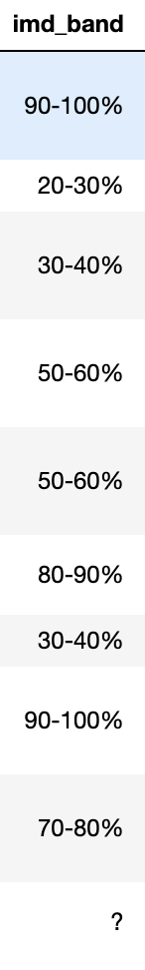
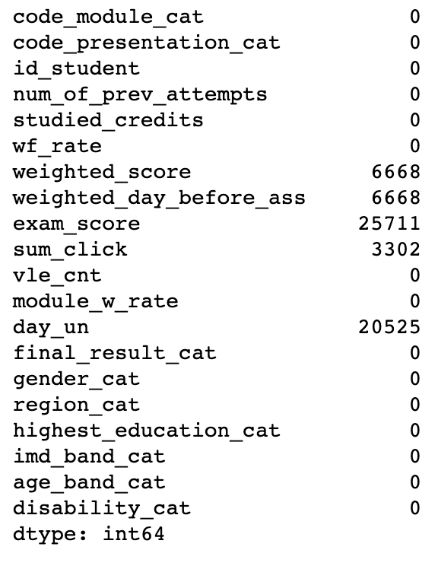
Data Cleaning
Missing Value
Didn’t take the assessment
Wrong Value
Didn’t click material in VLE
Didn’t unregister
Should be ‘> 100%’
Impute with -1
Notes:
I validated the wrong value in the imd_band column. For the missing values, there are 5 columns containing missing values. For the weighted_score, weighted_day_before_ass, which is the submission before the assessment due date, and exam_score, the missing value indicates students didn’t take this certain type of assessment, so it cannot be imputed with 0. Let’s take the weighted_score for example, 0 in the weighted_score column means the student took it and got 0 out of 100 for the grade which was not the real case. The missing value in the sum_click column means student didn’t resort to the VLE for help during their study. And the missing value in the day_unregistration means they didn’t unregister. I imputed all those missing values using -1.

Slide 20
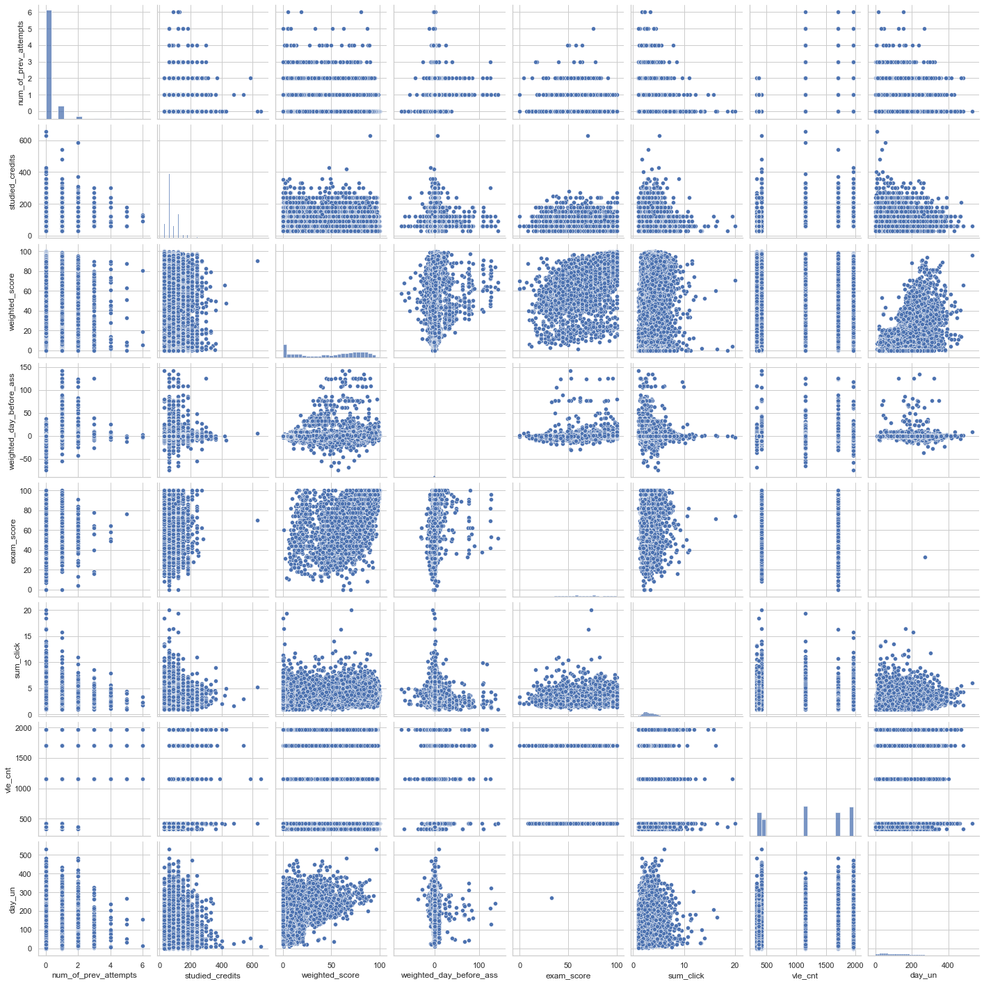
Data Cleaning
Outliers
studied_credits > 250
sum_click > 8
day_un > 450
submission_day_before_ass > 6 or submission_day_before_ass < -5
Remove them
Notes:
From the pair plot, which may not be very clear on my slides since it’s too small. We can see there are outliers in the 'studied_credits', 'sum_click’, 'day_un’ and ‘submission_day_before_ass’ features. I decided to drop these rows.

Slide 21
Data Cleaning
Label Encoding
code_module
AAA
BBB
CCC
DDD
EEE
FFF
GGG
……
code_module_cat
0
1
2
3
4
5
6
……
Notes:
Then I encoded all the categorical features using integer to make sure I can input them to the model.

Slide 22
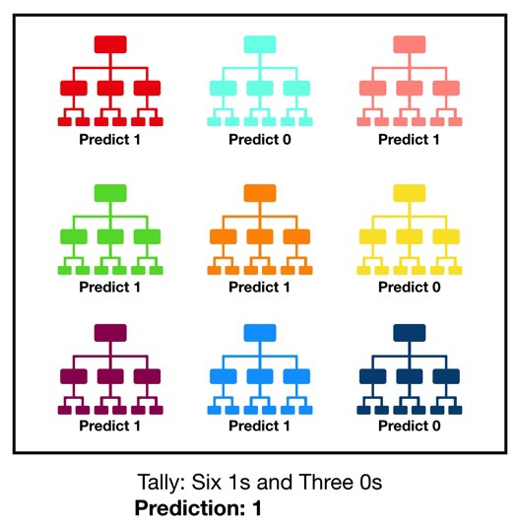
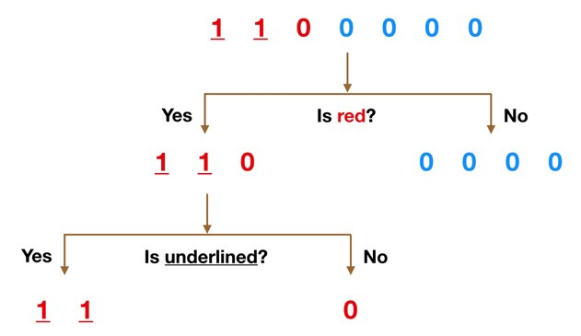
Feature Selection
Decision Tree
Random Forest
A large number of relatively uncorrelated trees.
Notes:
I used the random forest classifier in this project and I would like to briefly introduce it.
A decision tree is a graphical representation of all the possible solutions to a decision based on certain conditions.
A large number of relatively uncorrelated models (trees) operating as a committee will outperform any of the individual constituent models. The random forest is an algorithm consisting of many decisions trees. It uses bagging and feature randomness when building each individual tree to try to create an uncorrelated forest of trees whose prediction is more accurate than that of any individual tree.

Slide 23
Feature Selection
Demographical Features
Training Set: 80%
Test Set: 20%
Behavioral Features
Random Forest Classifier
Accuracy on Test Set: 87.2%
Notes:
I added all the students’ behavioral features into the student information dataset, and got a table contains student demographical information, behavioral information and their final results. Then I split this table into training set and test set, and input the training set into the rfc. Finally, the accuracy on the test set is 87.2%, which is good enough under this case.

Slide 24
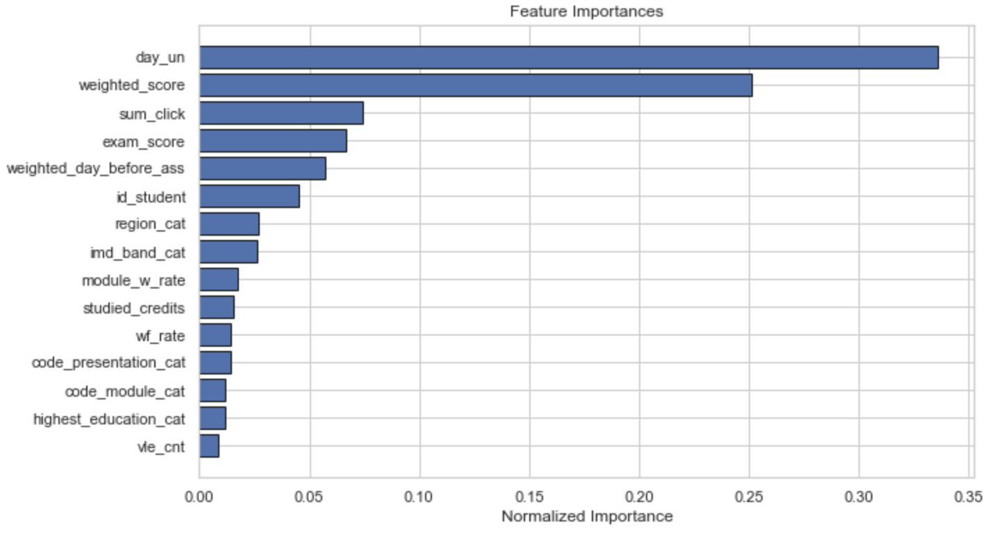
Feature Selection
Could be used as proxies of student final result
Notes:
The feature importance figure shows how each feature important in the model. We can see the behavioral features are highly correlated with student’s final result of each module-presentation， which totally aligns with our intuition. Day_un is the most important feature among all because once a student unregisters a class, it means the final result would be “withdraw” for sure. Weighted score is the second important, which directly correlated with the final result. The Sum of clicks is the 3rd important feature, we could plot it against the weighted score and analyze how they correlated in the analysis part later.

Slide 25

Forecasting
Demographical Features
Directly correlated the the final result
We can’t know them in advance
Training Set: 80%
Test Set: 20%
Behavioral Features
Random Forest Classifier
Accuracy on Test Set: 37.5%
Need more information to forecast!
Notes:
One of the project goals is to deliver a predictive model to forecast students’ final results in advance. In this part, we cannot use all the behavioral features in the model since they are directly correlated with the final result and we can’t know them in advance. Unfortunately, after dropping them, the accuracy is only 37.5%, which means the model can barely predict student’s final results using the demographical features we have. To achieve a better prediction, we need more information.

Slide 26
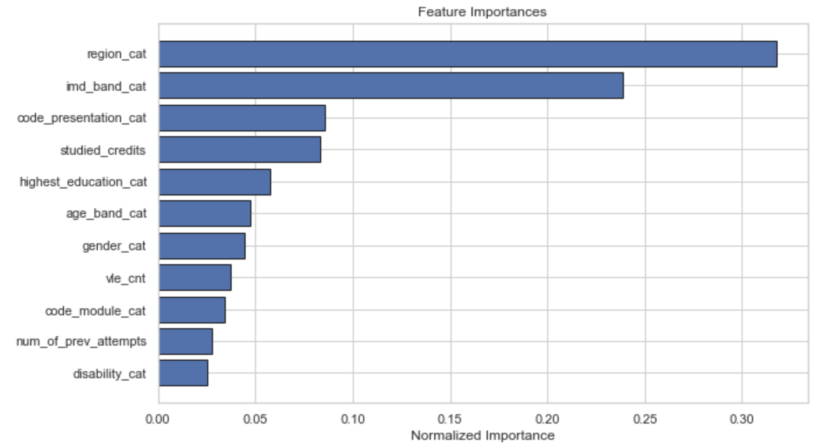
Forecasting
Let’s explore how they could impact on student final result!
Notes:
In the demographical features, region and imd_band contribute most to the prediction. Let’s how they impact on the students final results in the next section.
Is there any questions with the whole data science part?

Slide 27
Analysis
Hi!
Notes:
Let’s continue with the most exciting analysis part.

Slide 28
A Timeline Always Works Well
Measurement
Demographical Features
Behavioral Features
How they impact the final result?
How to deal with them?
How to prove the strategies we take will work?
Notes:
There are 3 sections I want to cover. I will analyze how the demographical and behavioral features impact the final results, and how to deal with these problems. After that, I will come up with a measurement to test if my suggestions work after launching.

Slide 29
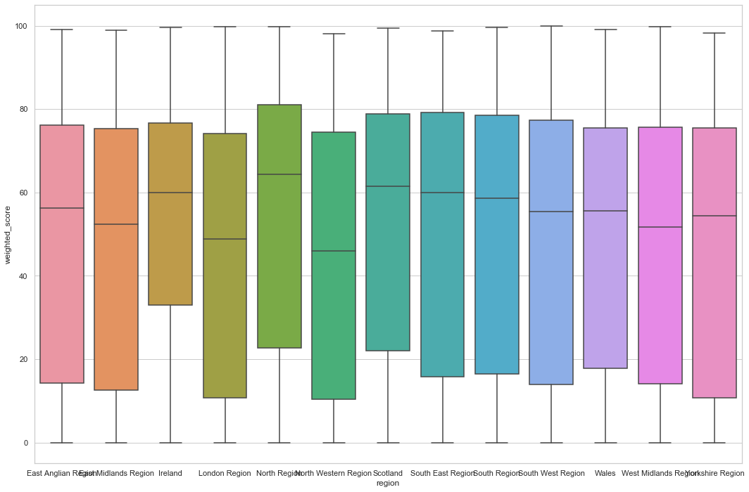
Demographical Features - Region
Weighted score VS Region
The weighted score in London Region & North Western Region is lower than others.
Age? No
Solutions:
Further investigate the policy, culture, special events, GDP, overall education level… in these 2 regions to figure out why that happen.
Notes:
Let’s look at how weighted scores differ across different regions. We can see The weighted score in London Region & North Western Region is lower than others. I further plotted a simple cross-tabulation of region and age but it turns out the distribution of age is pretty even across different regions, which means age is not the factor behind the region. So I recommend further investigate the policy, culture, special events, GDP, overall education level… in these 2 regions to figure out why that happen.

Slide 30
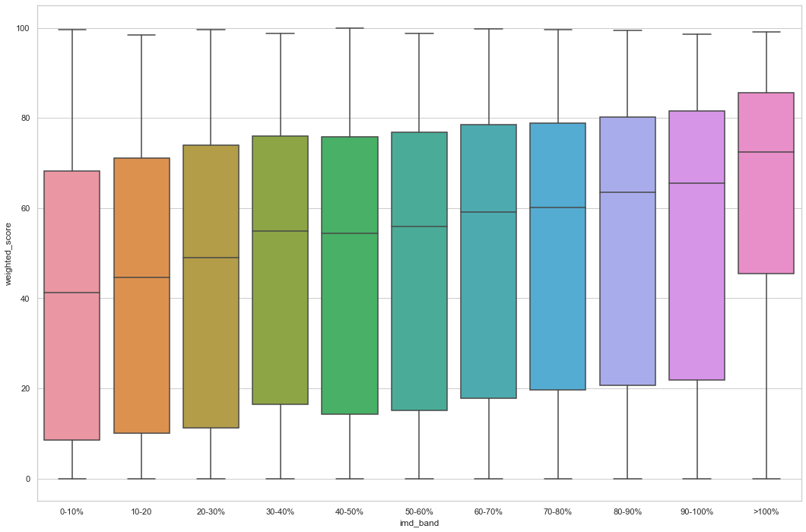
Demographical Features – imd band
Weighted score VS imd band
The less deprived the areas where the students live, the more likely they are to succeed
Solutions:
Offer free basic level educational resource in the deprived regions.
Break down students, personalized teaching.
Notes:
This figure is weighted score against imd_band, imd_band for Index of Multiple Depravation band of the place where the student lived. We can see an unpleastant result that The less deprived the areas where the students live, the more likely they are to succeed. Based on this, I suggest to offer free basic level educational resource in the deprived regions. I also suggest further investigate, breaking down students into 3 groups, , , research on each subgroup and generate personalized teaching strategy.

Slide 31
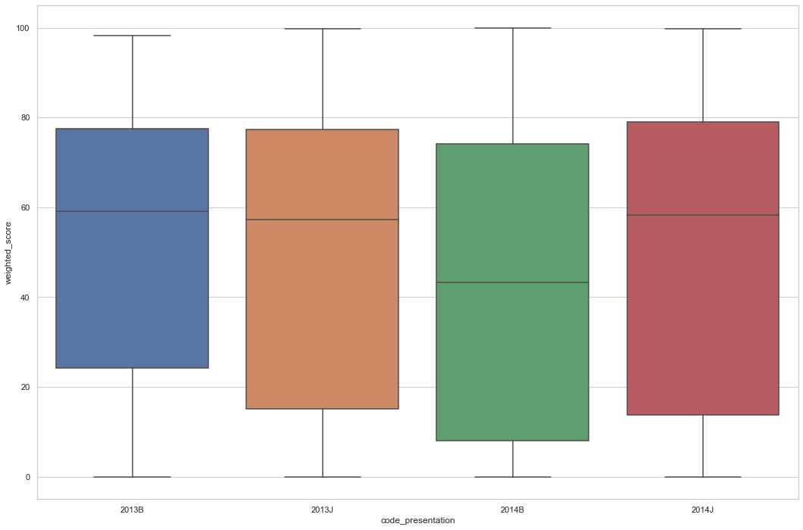
Demographical Features – code presentation
Weighted score VS code presentation
Student didn’t perform as good as other presentations in the 2014B
That looks wired!
Let’s dive deeper!
Notes:
When I try to find how different presentation impact students’ weighted score, I found a wired result that Students didn’t perform as good as other presentations in the 2014B.

Slide 32
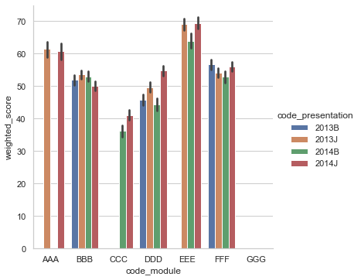
Demographical Features – code presentation
Module ‘AAA’ (higher average score) didn’t hold in 2014B
Module ‘CCC’ (lower average score) started from 2014
the code_presentation itself doesn't affect student result, it affects the weighted score simply because of the course arrangement.
Notes:
I further investigated the reasons behind that and found the module ‘aaa’ has a higher average score and didn’t hold class in 2014B, while module ‘CCC’ has a lower average score and started the first class in 2014B. So I concluded that the presentation itself doesn't affect student results, it affects the weighted score simply because of the course arrangement.

Slide 33
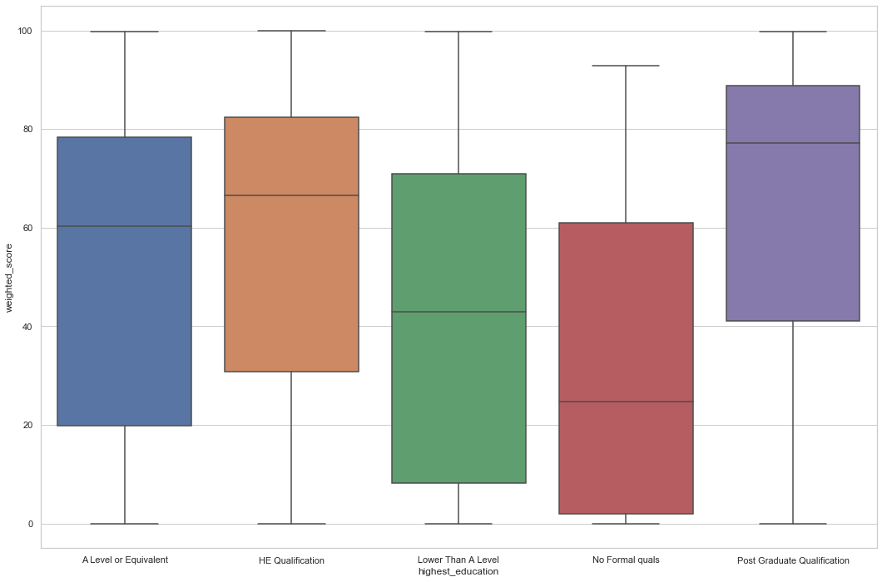
Demographical Features – highest education
Weighted score VS highest education
The higher education level, the more likely they are to succeed
Solutions:
Direct survey on students with lower education level.
Recommend more basic level courses to them.
Give promotions to encourage them take the courses of suitable difficulty.
Allocate tutors to them
Notes:
From the weighted score against highest education figure, we can see students who have post graduate qualification got hightest weighted score in the class while students with no formal qualifications got the lowest score. The higher education level, the more likely they are to succeed, which pretty aligned with our intuition. I put forward 4 solutions to the problem, firstly, conducting direct survey among students with lower education level to ask their pain points. Secondly, change the algorithm and recommend more basic level to them. Thridly, give promotion to encourage them take the courses of suitable difficulty. lastly, Allocate tutors to help them.

Slide 34
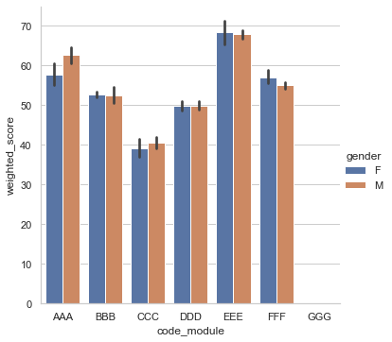
Demographical Features – Gender
Gender does not seem to have a significant impact.
Notes:
Since female and male students got almost the same average weighted score of different modules, Gender does not have a significant impact.

Slide 35
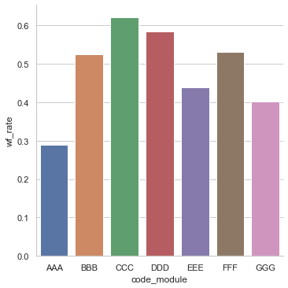
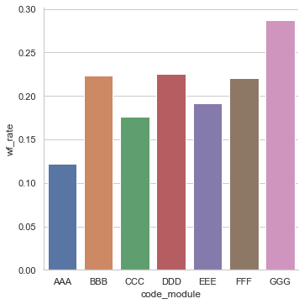
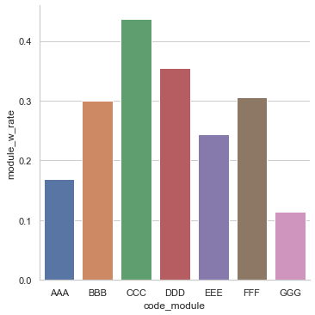
Demographical Features – Module
Module fail or withdraw rate
Module fail rate
Module withdraw rate
Module ‘GGG’ may be both compulsory and difficult, for its low withdraw rate and high fail rate.
Module ‘CCC’ may be a hard course or have a low quality, for the withdraw rate is the highest.
The fail or withdraw rate of module ‘BBB’, ‘DDD’ and ‘FFF’ is also high.
Notes:
I plotted the the module fail or withdraw rate, module fail rate as well as the module withdraw rate. From these 3 figure, I found module ‘GGG’ Module ‘GGG’ may be both compulsory and difficult, for its low withdraw rate and high fail rate. Module ‘CCC’ may be a hard course or have a low quality, for the withdraw rate is the highest. The fail or withdraw rate of module ‘BBB’, ‘DDD’ and ‘FFF’ is also high. Students performed better on module ‘AAA’ and ‘EEE’, hopefully we can learn from these 2 modules and adjust other modules.

Slide 36
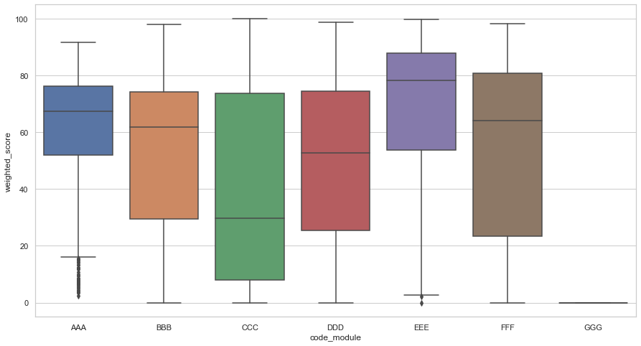
Demographical Features – Module
How did the module ‘GGG’ be evaluated? Look at the data, both assessment score and exam score is 0.
The result of module ‘CCC’ is the worst!
The result of module ‘BBB’, ‘DDD’ and ‘EEE’ is not as good as module ‘AAA’ and ‘EEE’.
Notes:
This is the weighted score for each module, like I said, module ‘aaa’ and ‘eee’ has better results compare to others. The result of module ‘CCC’ is the worst! The result of module ‘BBB’, ‘DDD’ and ‘EEE’ is not as good as module ‘AAA’ and ‘EEE’.

Slide 37
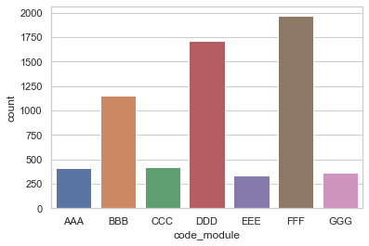
Demographical Features – Module
The VLE count for each module
The workload of module ‘BBB’, ‘DDD’ and ‘FFF’ is bigger than ‘AAA’ and ‘EEE’
Solutions:
Split each of the module ‘BBB’, ‘DDD’ and ‘FFF’ into two modules(eg. module ‘DDD1’ module ‘DDD2’ ), and each new module still take one presentation. Try to reduce the workload in each module and improve result.
Notes:
This figure shows the vle count for each module, vle count is a metrics we defined at the beginning, it indicates the workload of each module. We can see The workload of module ‘BBB’, ‘DDD’ and ‘FFF’ is bigger than ‘AAA’ and ‘EEE’. I suggest to reduce the workload of these 2 modules by splitting each of them into two modules.

Slide 38
Demographical Features – Module
Module ‘DDD’
Reduce the workload
Module ‘DDD1’
Module ‘DDD2’
2021B
2021J
Notes:
For example, we can split module ‘DDD’ into module ‘DDD1’ and module ‘DDD2’. If each of them still takes one presentation, the workload of module ‘DDD’ could be diluted into 2 presentations.

Slide 39
Demographical Features – Module
The VLE count for each module
The workload of module ‘CCC’ and ‘GGG’ is almost the same with ‘AAA’ and ‘EEE’
Solutions:
Collaborate with the module providers to investigate what the problems are. Too difficult? The way of teaching? Quality of material? Mentorship?
Come up with possible strategies according to the problem. (eg. Hierarchical teaching）
Notes:
While we can also see that The workload of modules ‘CCC’ and ‘GGG’ is almost the same with ‘AAA’ and ‘EEE’. Since there is no difference in the workload, how can we do next? I suggest collaborating with the module providers to investigate what the problems are. Too difficult? The way of teaching? Quality of material? Mentorship? And then come up with solutions accordingly. For example, if the module itself is too difficult, we can conduct Hierarchical teaching, assign students with lower scores to the easy version module and students with higher scores to the difficult version module.

Slide 40
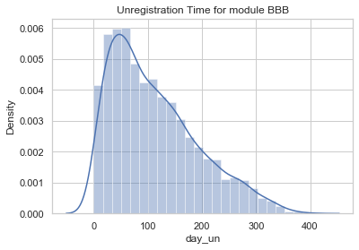
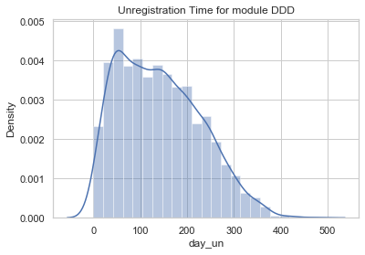
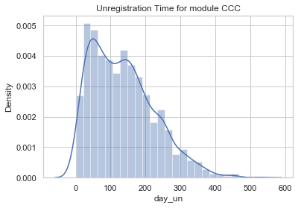
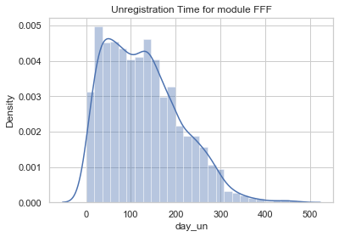
Behavioral Features – Unregistration Time
In most case, student drops a module after 30 – 50 days of registration.
Solutions:
Direct Survey: Ask students why withdraw once they click the withdraw button.
Give them incentives to continue the course when they decide to withdraw. (eg. More credits if they chose to continue)
Notes:
I plotted the unregistration time for modules with high withdraw rate. I found in most case, student drops a module after 30 – 50 days of registration. Based on that, I recommende to conduct direct survey to Ask students why withdraw once they click the withdraw button. In addition, the open university can Give them incentives to continue the course when they decide to withdraw. (eg. More credits or odder a cupons if they chose to continue)

Slide 41
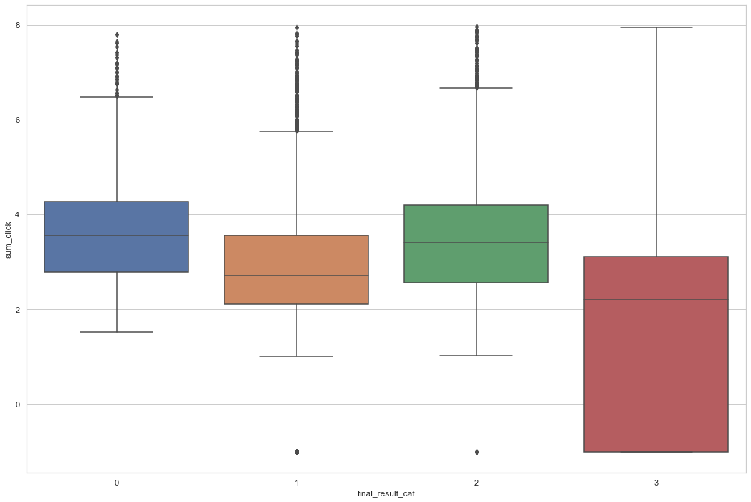
Behavioral Features – Sum of Clicks
Sum of clicks VS final result
More clicks on the material in the VLE, better result.
Students pass but also no clicks
Solutions:
Incentive students to let them go to the VLE more and use the material more (eg. Give them credits once they finished 2 hours learning in the VLE per week).
Distinction
Fail
Pass
Withdrawn
Notes:
Now let’s look at how the sum of clicks impacts on the final result. The result is pretty in accordance with our intuition. More sum of clicks on the vle can lead to a better result. Envn though there were few students who passed the class with no clicks, but all students with distinction clicks and clicks more times than other students. Based on this, I suggest to incentive students to use the VLE more. For example, the ou could give students extra credits once they finished 2 hours learning in the VLE per week.

Slide 42
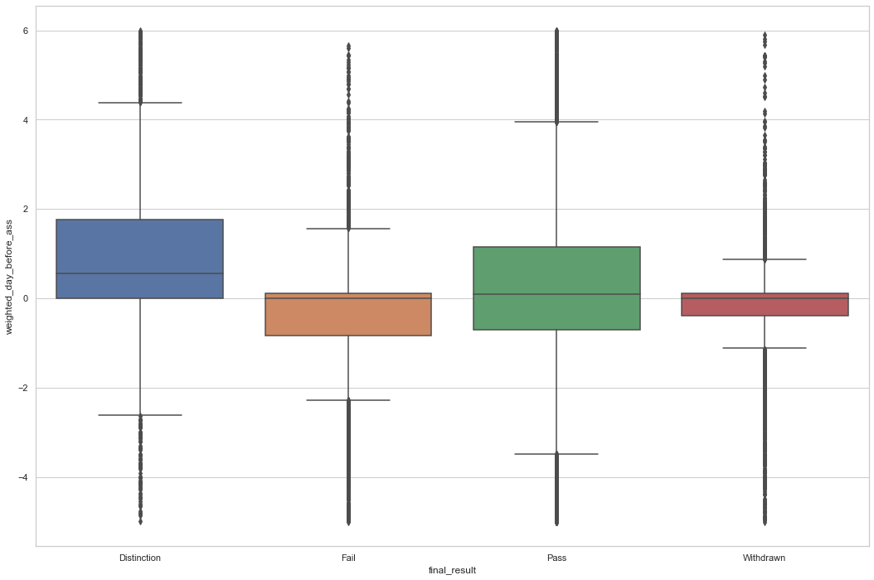
Behavioral Features – Submission Before Assessment Due Date
Submission before assessment VS final result
Earlier submission, better result.
Solutions:
Incentive students to finish the assessment and submit earlier. (Give them credits as the same amount of their early submission days.)
Notes:
Finally, let’s look at how the timeliness of submission impacted the final result. We can see from the figure that Earlier submission could bring better results since students with distinction and pass submitted their assignments earlier than students with fail. I suggest to Incentive students to finish the assessment and submit it earlier. For example, the ou could give students extra credits as the same amount of their number of days to submit assignments before the due date.

Slide 43
Behavioral Features – Measurement
The overall idea:
Implement the strategies.
Track metrics we care about.
See if the metrics go where we want.
Cannot use the final result as the metric, because we need to wait too long time to get it.
Instead, use the weighted assessment score, unregistrationand sum of clicks as proxies of the final result.
Notes:
So far, I analyzed the potential causes of the fail or withdraw of a class, as well as the corresponding solutions. How can I make sure these strategies work after launching? I designed a 3-step measurement. Firstly, implement the strategies, secondly, track metrics we care about, and lastly, see if the actions we took to move the metrics to the direction er want. In the second step, metrics we care about means metrics directly correlated with the final result. we cannot use the final result because we need to wait too long time to get it since one module-presentation normally would take 9 months. Instead, we can use weighted assessment scores, unregister, and the sum of clicks as proxies of the final result, that we can get these metrics one month after launching the solutions or quicker.
Is there any questions with the whole data science part?

Slide 44
Conclusion
Notes:
Finally, let me draw a conclusion.

Slide 45
Summary
Defined relevant metrics that could impact the student final result.
Found potential causes of low performance from both demographical and behavioral perspective.
Need more data and varied features to predict future result.
Made corresponding solutions and measurement methods.
Notes:
There are 4 goals for this project as I introduced in the beginning of the presentation, and I achieved 3 of them. I firstly defined and extracted revelant metrics that could impact the student final result. And then I Found potential causes of low performance from both demographical and behavioral perspective. In addition, I Made corresponding solutions and measurement methods. Unfortunately, I failed to use the current dataset to predict students’ future result.

Slide 46
Limitation & Future Work
Model selection
(parameters, supervised VS unsupervised)
Need more varied features
The dataset is too old, small
Notes:
I failed on the prediction partly because of the limitation of the dataset. The data only contains information from 2013 – 2014, if I have more data, I would try to predict students’ performance based on their previous behavior. I also look forward to inputting more features in my model such as student’s career and income. If I have these data, I hope I could develop a more elaborated model by trying different models and tuning parameters.

Slide 47
Thanks
Do you have any questions?
Xiaoran.Li@ur.Rochester.edu
+1 5857641431
https://www.linkedin.com/in/xiaoransharonli/
Notes:
Thank you for being here and watching my presentation today. Please let me know if you have any questions.

